Slide 1
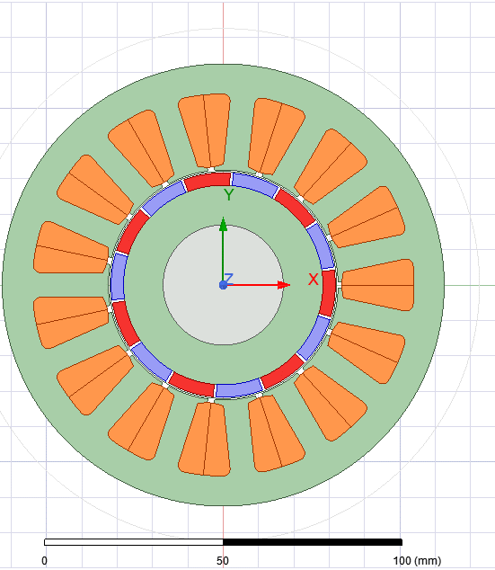
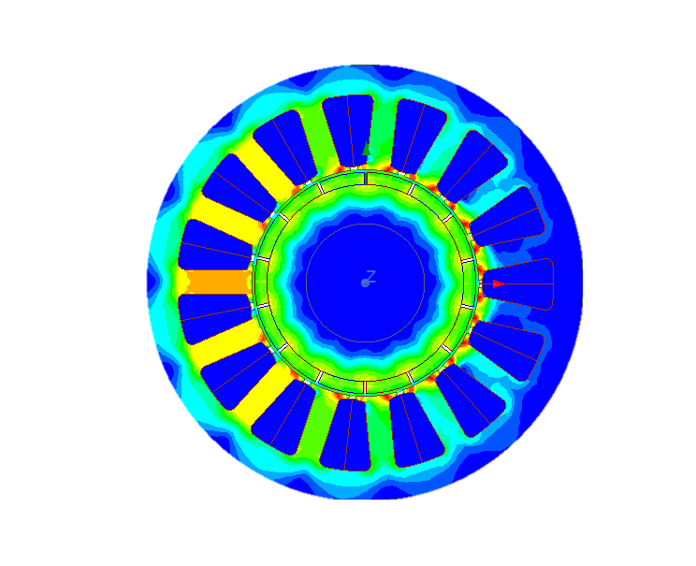
Parameter estimation of Surface mounted permanent magnet BLDC motor in Ansys Maxwell
Sandeep Mohan Nayak

Slide 2
Content
Problem statement
Geometry
Governing equations
Meshing
Boundary conditions
Post processing
Results

Slide 3
Problem statement
In this report, the parameters (magnetic loading, self-mutual inductance and back emf) of the surface mounted permanent magnet (SPM) BLDC motor is calculated and plotted using Ansys Maxwell. Magnetostatic analysis is used to calculate magnetic loading and inductance of the 1HP, 1500 RPM SPM BLDC motor. Similarly, transient solver is used to plot the back emf of the BLDC motor. This report validates the shape of the back EMF (trapezoidal) and match the magnetic loading (0.8T) with the design assumption.

Slide 4
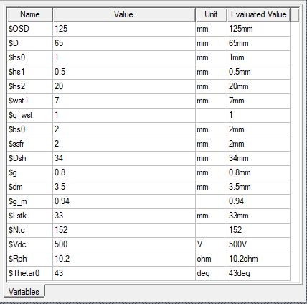
2D Geometry of IPM BLDC motor
Part Name | Material
Stator &Rotor Core | M350_50A
Magnet | N42UH_60C
Shaft | Stainless steel
Winding | Copper
https://drive.google.com/file/d/1lfAvoQk4U6eQjun65Yz1upUx1T3Vtdw-/view

Slide 5
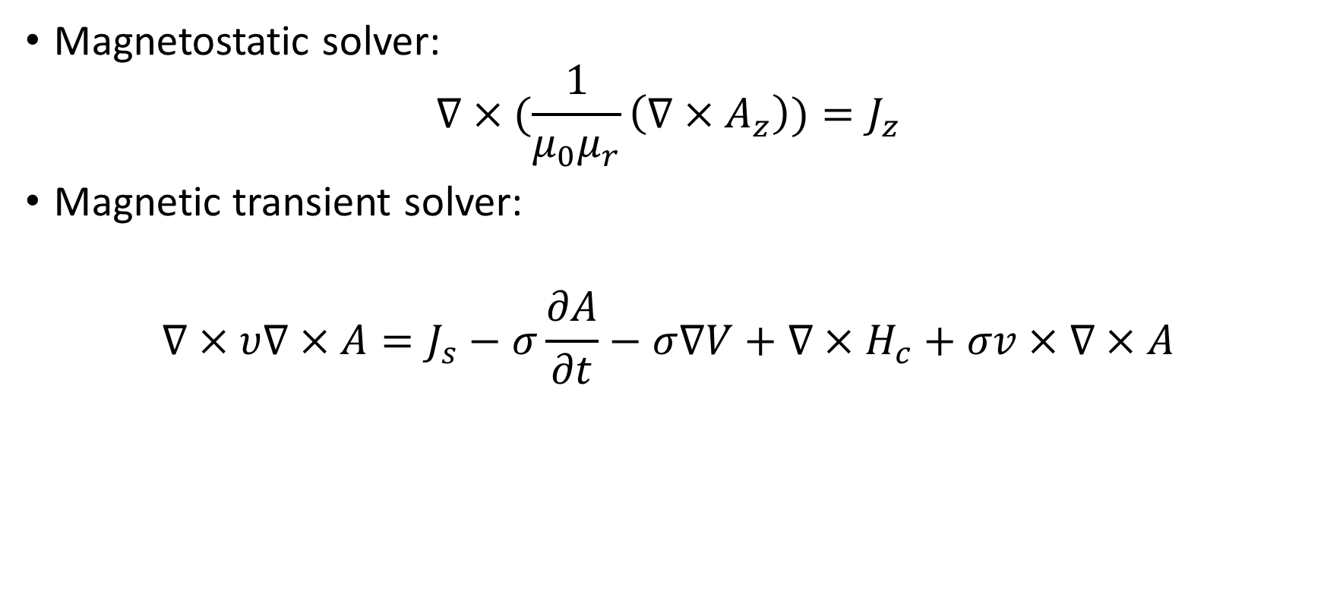
Governing equations
Magnetostatic solver:
$$∇×(\frac{1}{μ_{0}μ_{r}}\left(∇×A_{z}\right))=J_{z}$$
Magnetic transient solver:
$$∇×υ∇×A=J_{s}−σ\frac{∂A}{∂t}−σ∇V+∇×H_{c}+σv×∇×A$$
Velocity
Source Current density
Magnetic Vector Potential
Electric scalar Potential
Permanent Magnet

Slide 6
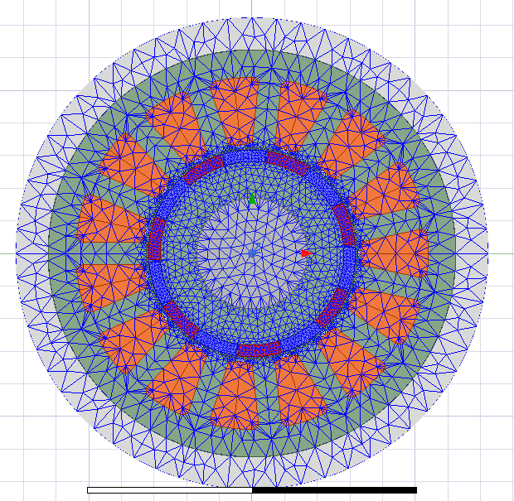
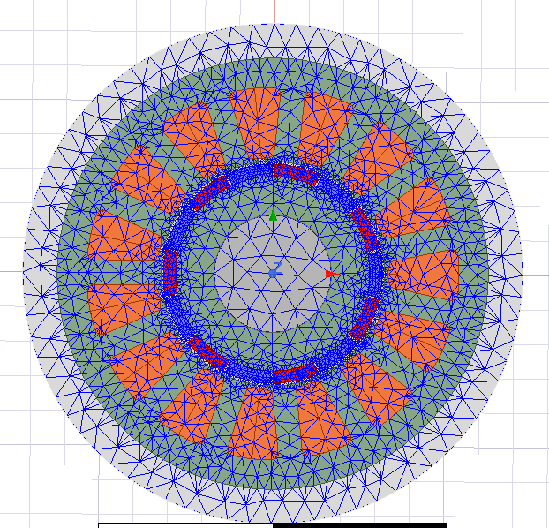
Meshing
Transient
Meshing is done by the mesh generator (MG) in Ansys maxwell.
Initial mesh is very coarse and uniform in size throughout the region.
There are optional mesh refinement methods that provide the MG with mesh construction guidance.
Length based refinement: This instruct the MG to refine the length of the finite element on a surface or within a volume until they are below a specified value
Surface based refinement: This refinement instructs MG to minimize the surface deviation and normal deviation of finite element on surfaces.
Adaptive mesh refinement: This allows optimized refinement of the mesh learned on specific criteria required by the problem. It takes the factor like (geometry factor, field solution factor defined by the user)
Magnetostatic

Slide 7
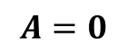
Boundary Condition
Boundary conditions define behavior of the magnetic field at the interface or the edge of the problem region.
Boundary types (2D)
Vector potential: (Dirichlet Condition)
Used to model magnetically isolated structure.
Contain all the flux within the region.
This is the end of the solution region.
$$A=0$$

Slide 8
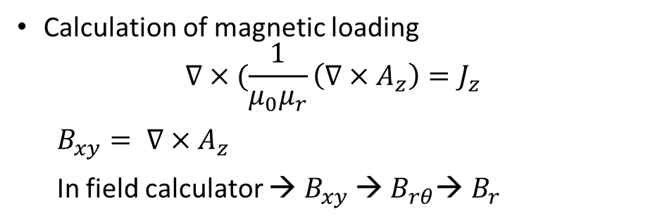
Post processing (Magnetostatic)
Calculation of magnetic loading
$$∇×(\frac{1}{μ_{0}μ_{r}}\left(∇×A_{z}\right)=J_{z}$$
$B_{xy}= ∇×$ $A_{z}$
In field calculator → $B_{xy}$ → $B_{rθ}$→ $B_{r}$

Slide 9
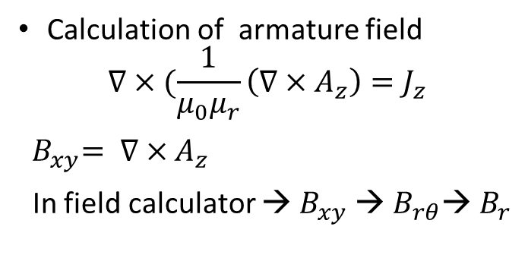
Post processing (Magnetostatic)
Calculation of armature field
$$∇×(\frac{1}{μ_{0}μ_{r}}\left(∇×A_{z}\right)=J_{z}$$
${ B}_{xy}= ∇×$ $A_{z}$
In field calculator → $B_{xy}$ → $B_{rθ}$→ $B_{r}$

Slide 10
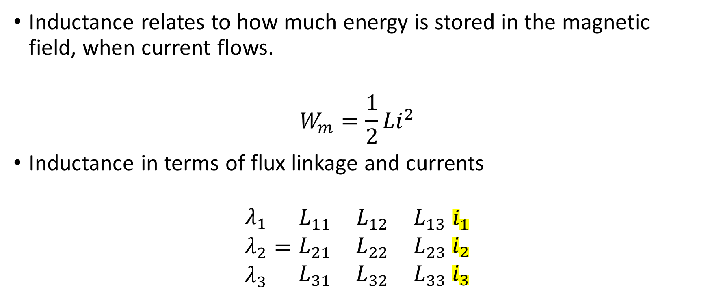
Inductance calculation
Inductance relates to how much energy is stored in the magnetic field, when current flows.
$$W_{m}=\frac{1}{2}Li^{2}$$
Inductance in terms of flux linkage and currents
$$\begin{matrix}λ_{1} \\ λ_{2} \\ λ_{3}\end{matrix}=\begin{matrix}L_{11} & L_{12} & L_{13} \\ L_{21} & L_{22} & L_{23} \\ L_{31} & L_{32} & L_{33}\end{matrix} \begin{matrix}i_{1} \\ i_{2} \\ i_{3}\end{matrix}$$
This energy is calculated from B and H

Slide 11
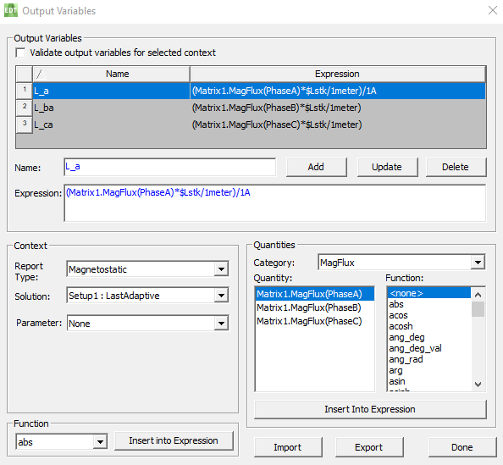
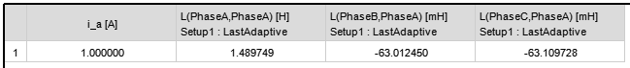
Inductance result
In each simulation, 1 amp is allowed to flow in phase-A.
No current flows in any phases.
Calculation of inductances manually
Calculation of inductances by the software (depth is 1 meter by default)
$$L\left(PhaseA,PhaseA\right)∗Lstk\left(m\right)=L_a$$

Slide 12
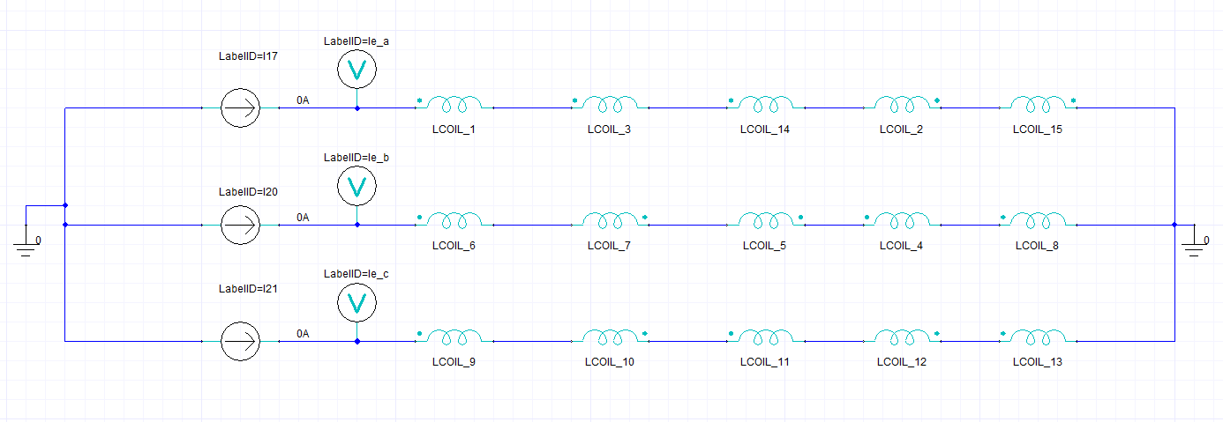
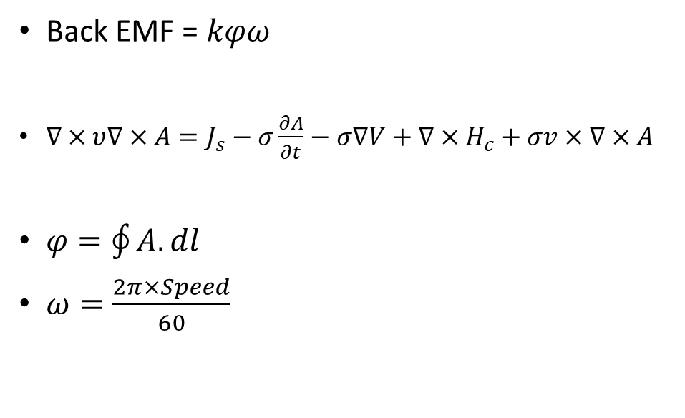
Back EMF
Moving Band
Back EMF = $kφω$
$∇×υ∇×A=J_{s}−σ\frac{∂A}{∂t}−σ∇V+∇×H_{c}+σv×∇×A$
$φ=\oint{A.dl}$
$ω=\frac{2π×Speed}{60}$
Circuit for back emf simulation

Slide 13
Result

Slide 14
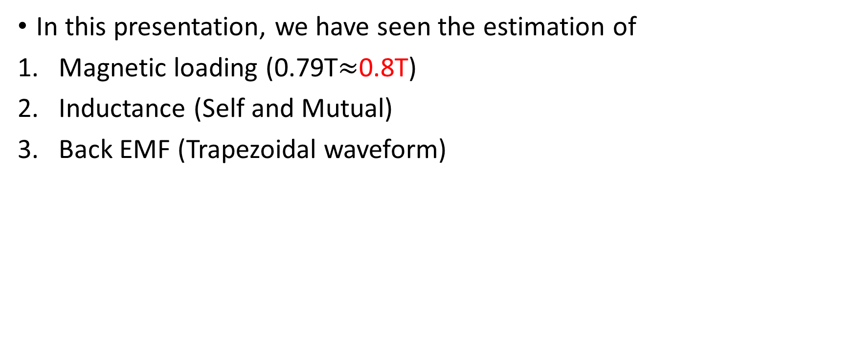
Conclusion
In this presentation, we have seen the estimation of
Magnetic loading (0.79T$≈$0.8T)
Inductance (Self and Mutual)
Back EMF (Trapezoidal waveform)

Slide 15
Reference
Maxwell 2D technical notes
Brushless permanent magnet motor design by Dr Duane C. Hanselman

